Slide 1
Credit Risk Analysis
Submitted By :
Arifhusen Ansari

Slide 2
Business Problem
Abstract
CredX is a leading credit card provider that gets thousands of credit card applicants every year. But in the past few years, it has experienced an increase in credit loss. The CEO believes that the best strategy to mitigate credit risk is to ‘acquire the right customers’.
In this project, you will help CredX identify the right customers using predictive models. Using past data of the bank’s applicants, you need to determine the factors affecting credit risk, create strategies to mitigate the acquisition risk and assess the financial benefit of your project.
Objective
Objective is to build predictive model to correctly identity the potential defaulter, when they apply to for the loan. Try to reduce credit loss by predicting correctly. Also, model must be good enough to predict so bank will not lose money by not giving credit card to good customers. We will build the score card for applicant based on the model.

Slide 3
Problem Solving Approach and Steps
Define the Problem
Data Understanding
Implement EDA
Model building
EDA to understand behavior of variables.
Cleaning Data
Cleaning data
Modeling
Define Business Problems and decide goals.
Data understanding at initial level.
Plot graphs, Uni variate, Bi variate analysis.
Derive and Formatting as per requirement.
Final model selection and Score card
Business Importance of Model
Conclusion

Slide 4
Data Understanding
We have two datasets
Demographic
Credit Bureau
There are two type of customers. Classified as below
Non Defaulters (Good): 0
Defaulters: 1
Details about data available.
Total Observation: 71295
Missing Status: 1425 (Rejected by old system, which might be manual or pre defined point calculation logic. Will be excluded from Analysis)
Total Observation: 66922 (This is after excluding Missing status applications)
Among all applicant around 2948 (4.2%), are defaulters, with $ 3,704,984,230 outstanding.
Road Map
EDA for Demographics data only and understand how it has impact on defaulters.
EDA using Demographics and Credit Bureau data and understand the impact.
Building model using different modeling technique with different hyperparameter. Select the best model
Build score card, get the cutoff score. Find saving on credit loss and find impact on revenue by not giving credit card to good customers
Conclude business benefit of project.

Slide 5
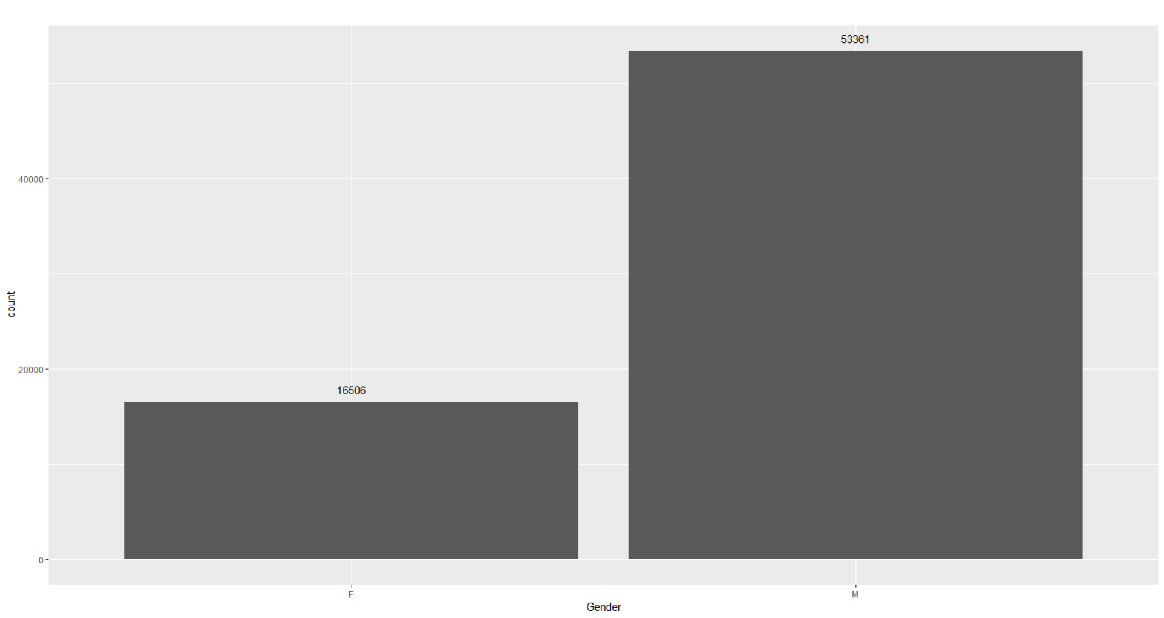
Data Understanding Graphs (Demographics)

Slide 6
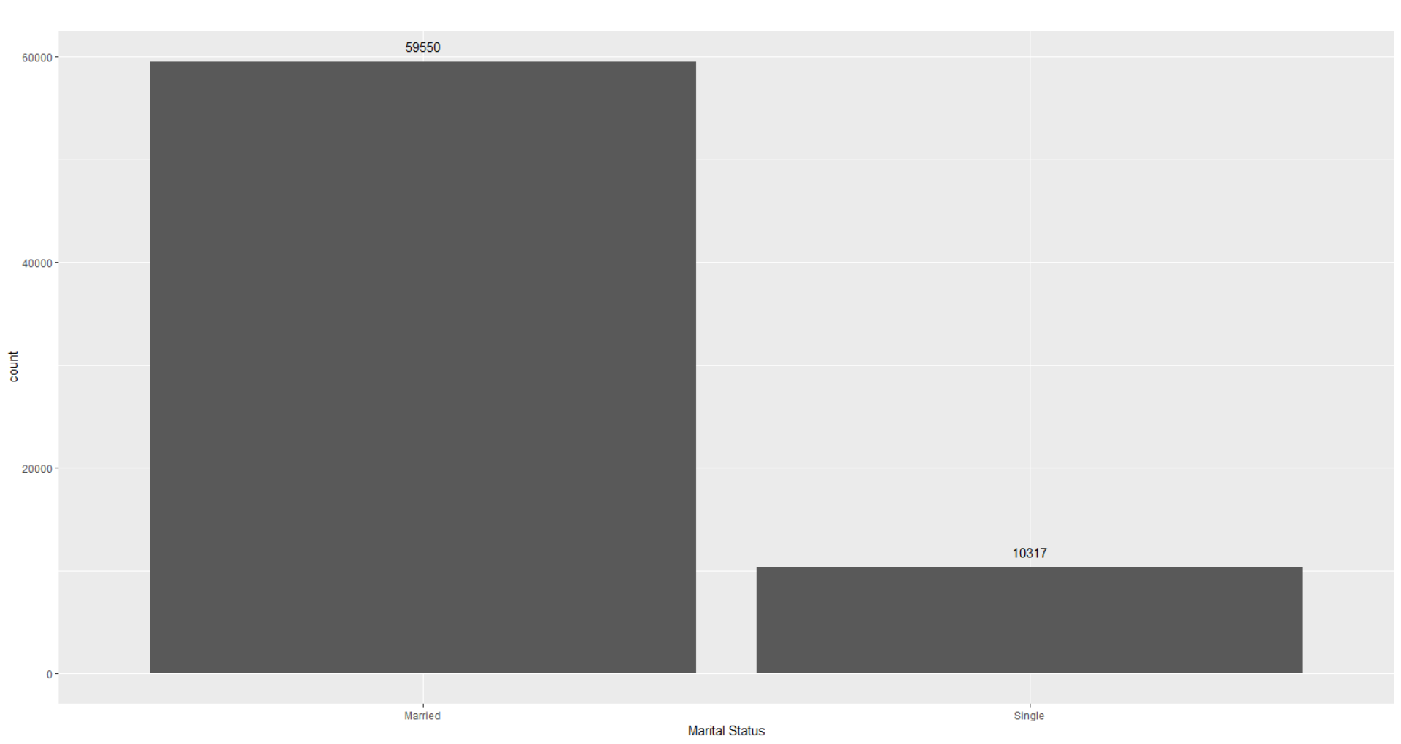
Data Understanding Graphs (Demographics)

Slide 7
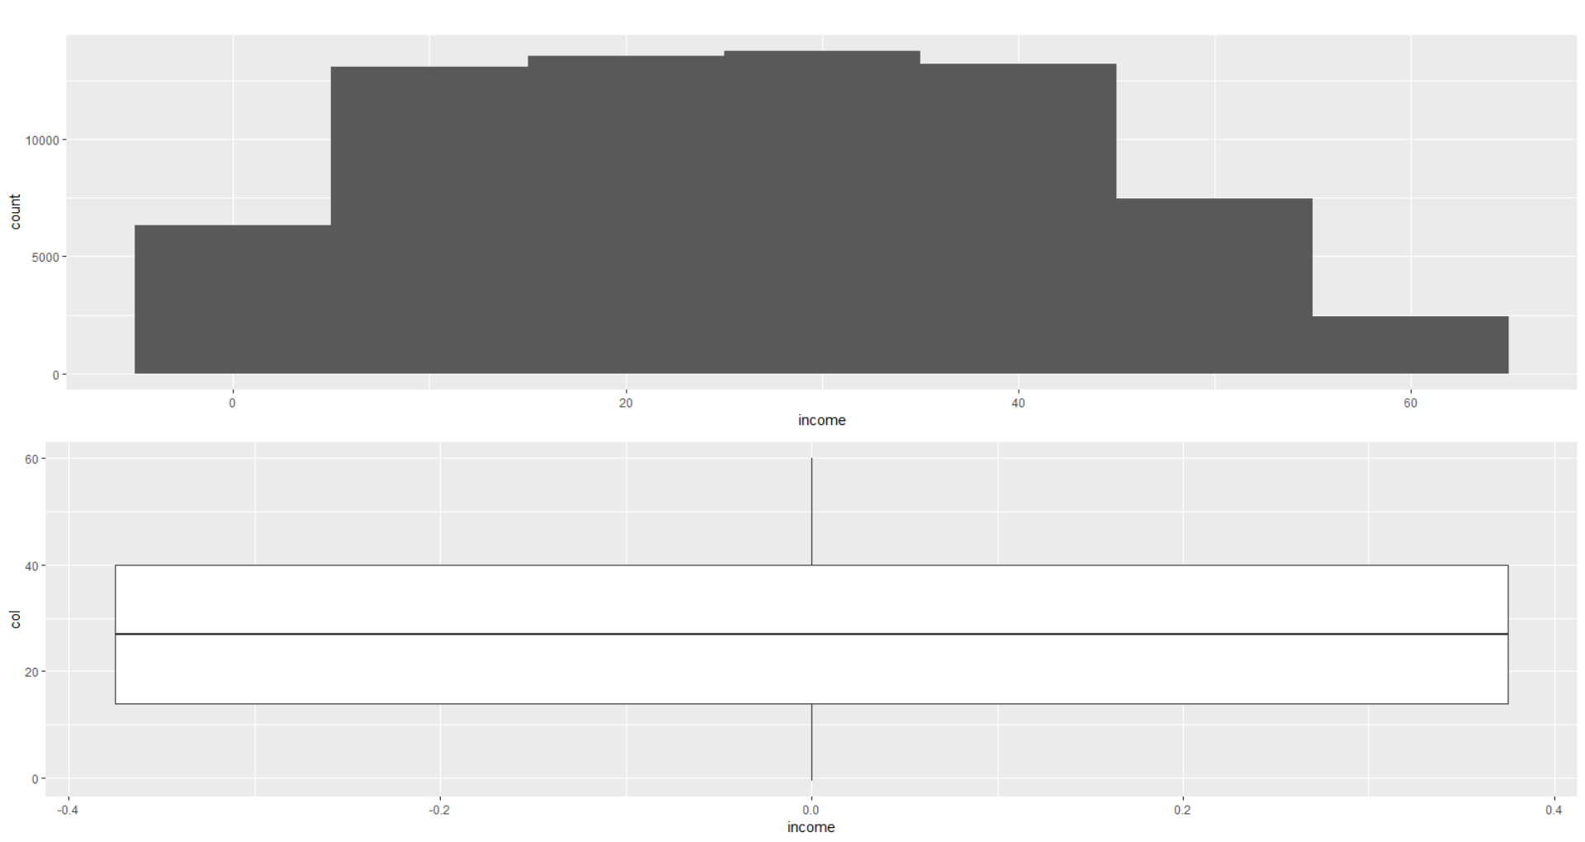
Data Understanding Graphs (Demographics)

Slide 8
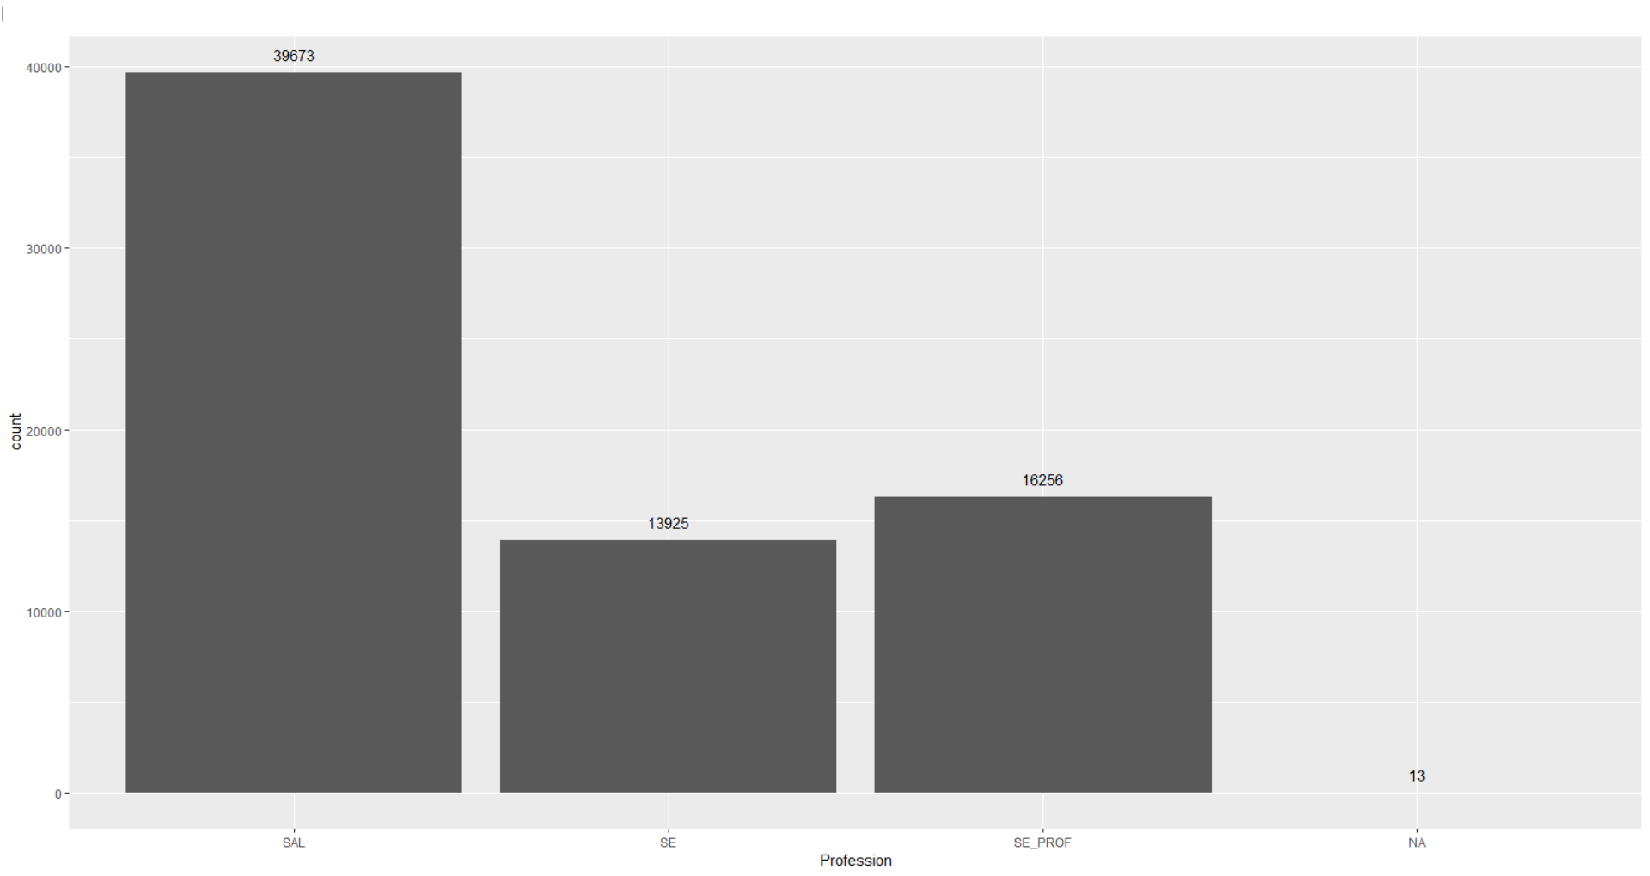
Data Understanding Graphs (Demographics)

Slide 9
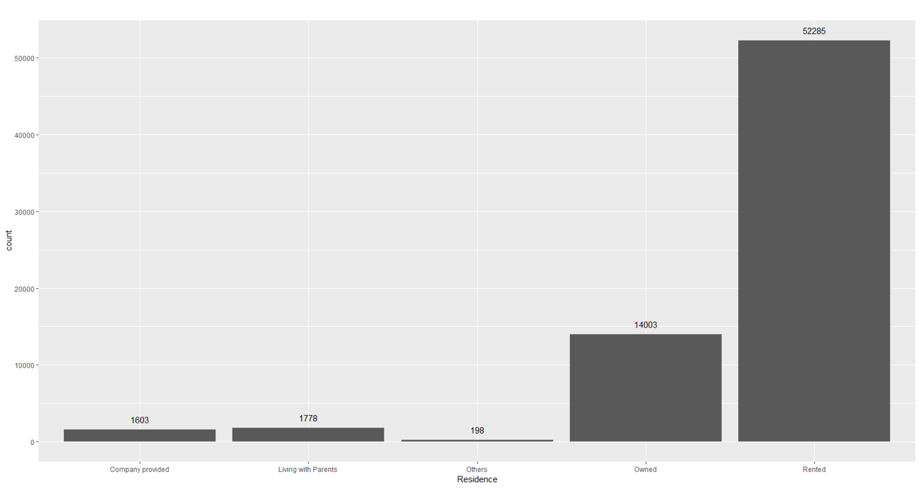
Data Understanding Graphs (Demographics)

Slide 10
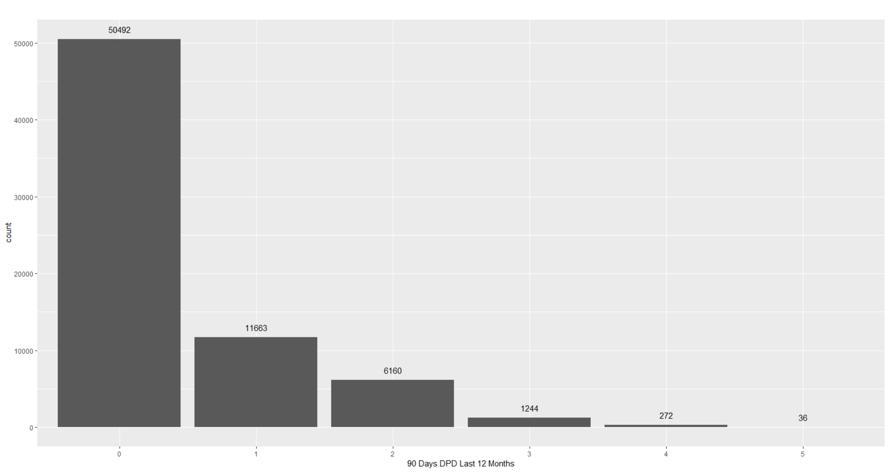
Data Understanding Graphs (Credit Bureau)
Almost 28% having, at least one, 90 Days DPD in last 12 months

Slide 11
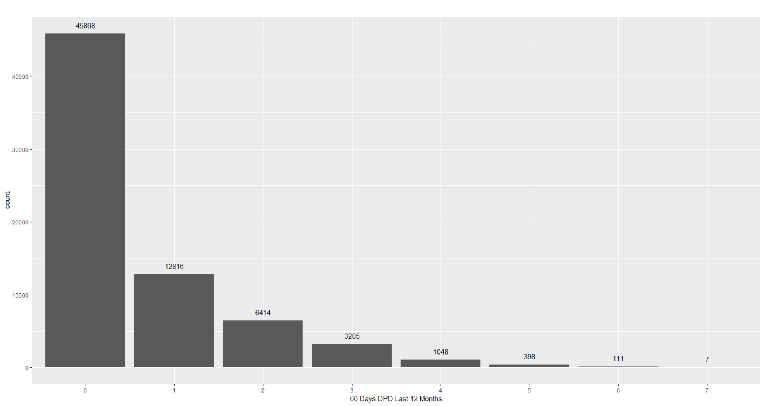
Data Understanding Graphs (Credit Bureau)
Almost 34% having, at least one, 60 Days DPD in last 12 months

Slide 12
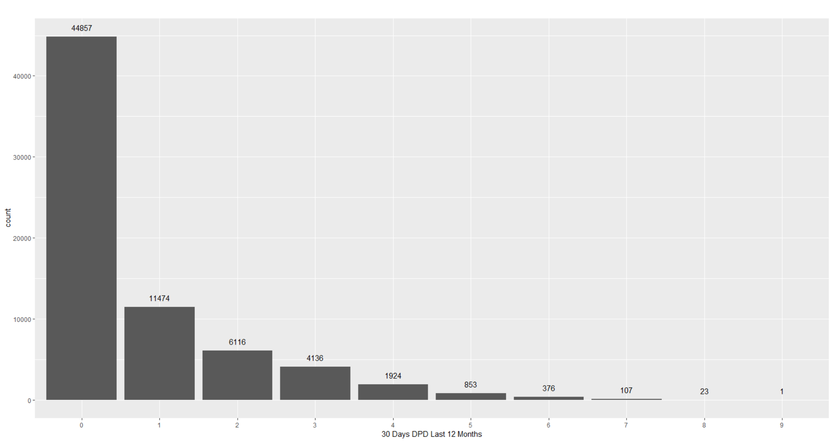
Data Understanding Graphs (Credit Bureau)
Almost 36% having, at least one, 30 Days DPD in last 12 months

Slide 13
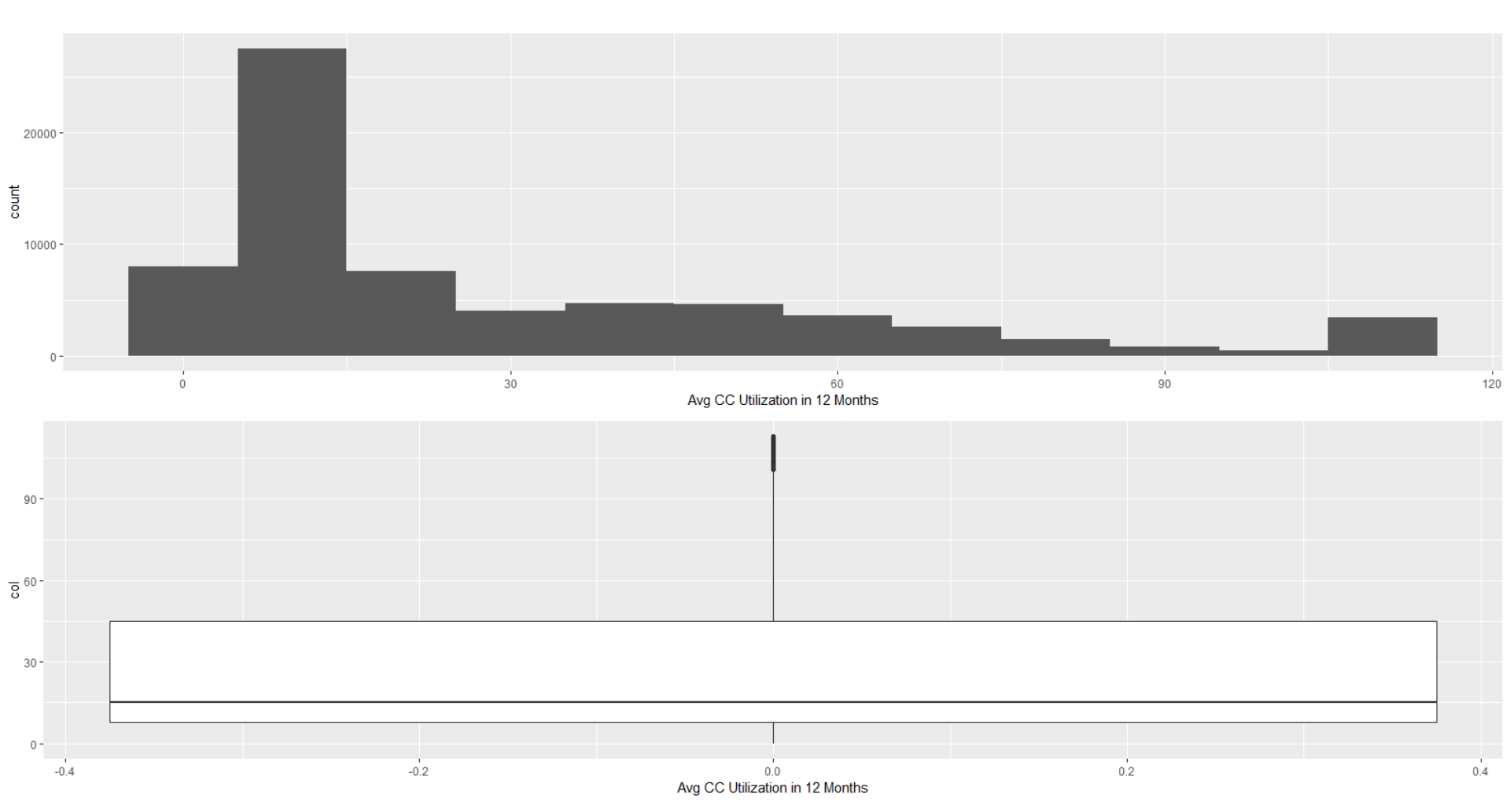
Data Understanding Graphs (Credit Bureau)
Almost 50% applicants having card utilization less than 15 in a year

Slide 14
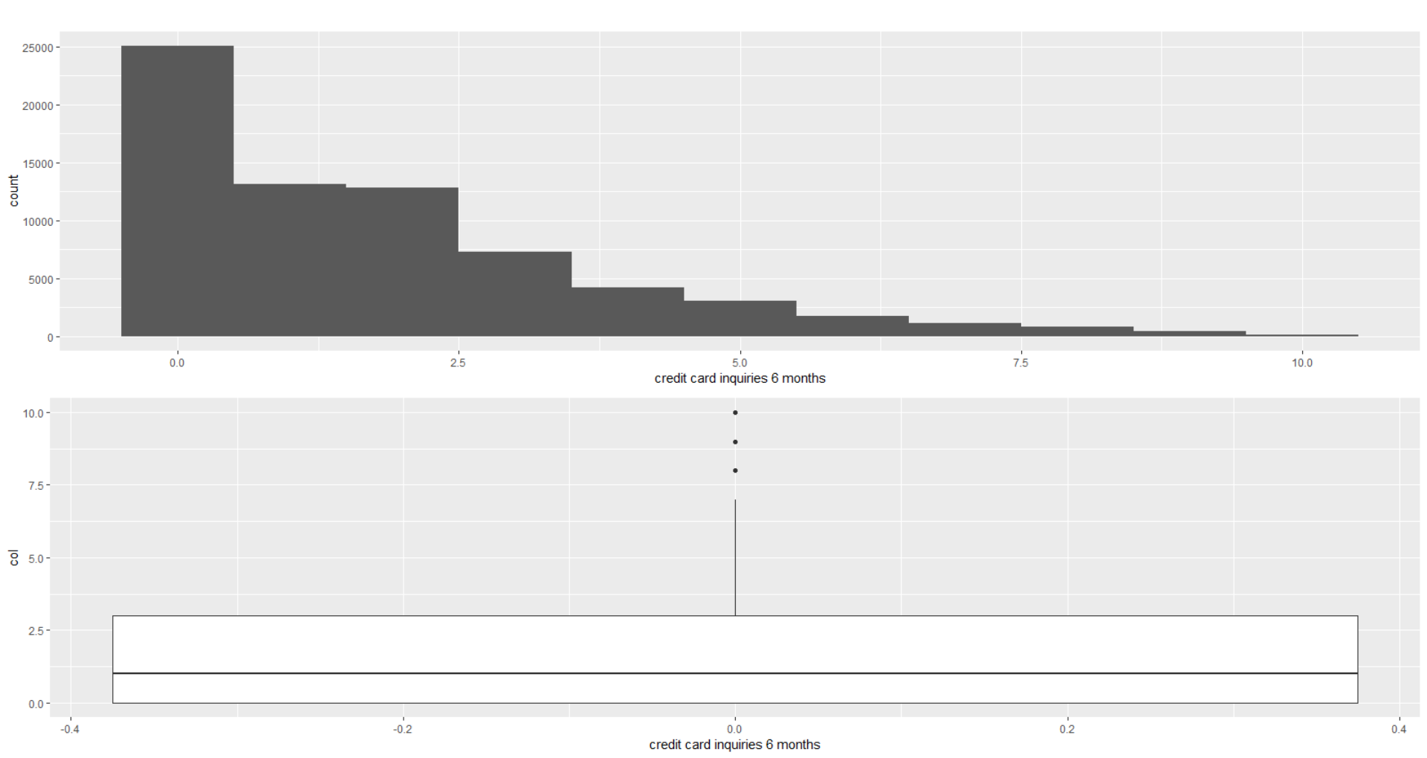
Data Understanding Graphs (Credit Bureau)

Slide 15
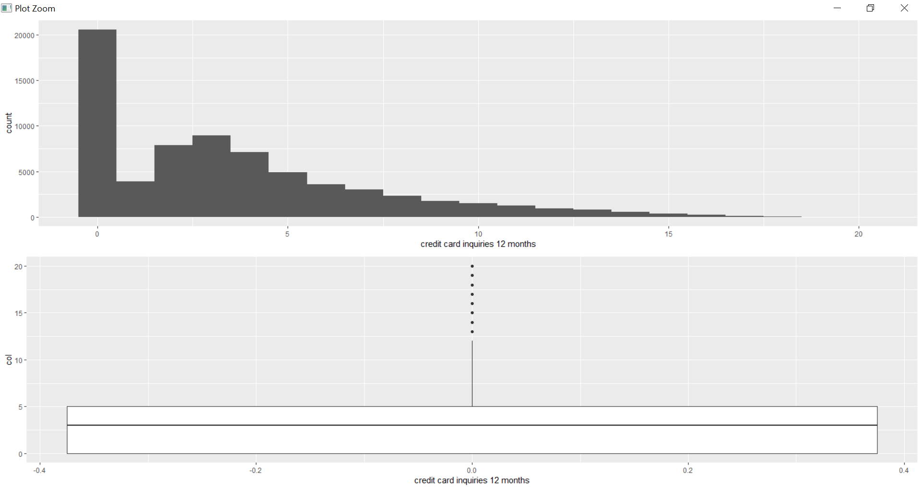
Data Understanding Graphs (Credit Bureau)

Slide 16
EDA (Exploratory Data Analytics)

Slide 17
Multivariate Analysis

Slide 18
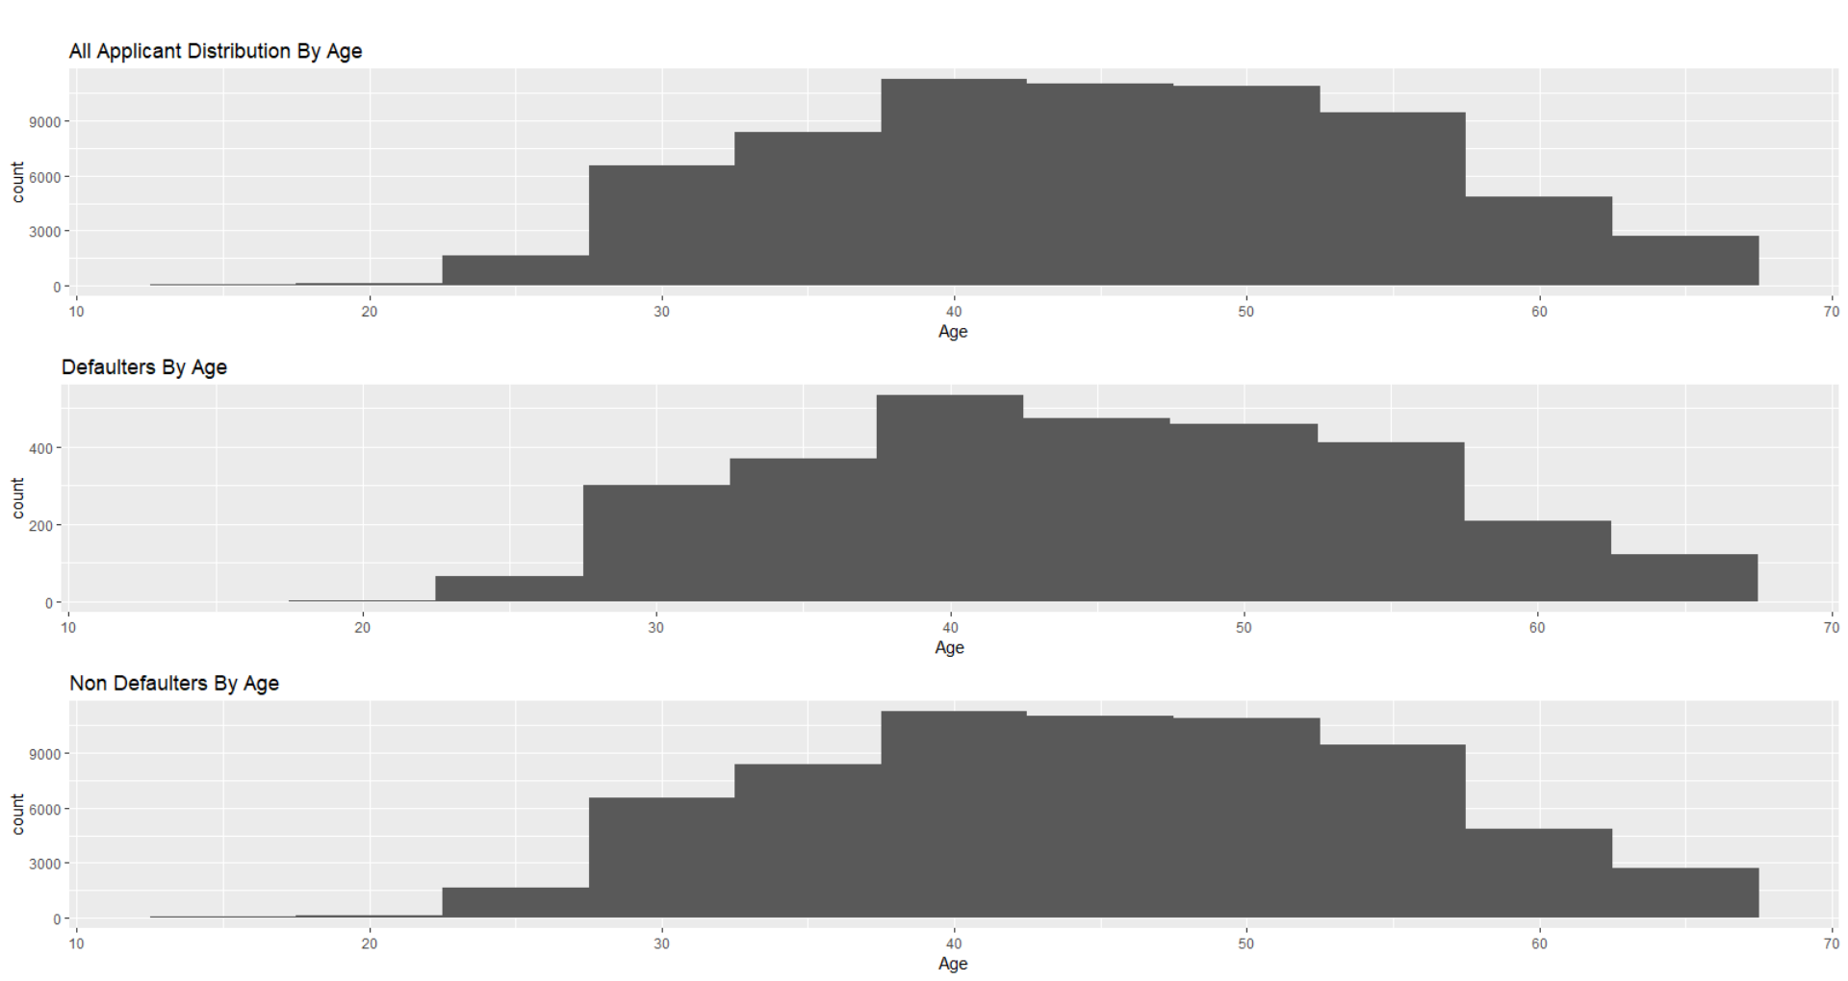
Age
All applicants are distributed normally, if we analyze distribution by Age.
Defaulters having same distribution as we do have for All applicants. we have more defaulters for the age between 35 to 60, because we have more number of applicants within that Age. It’s likely to have more defaulters in that Age range, since number of applicants are high.
This behavior is same in case of Non Defaulters. Curve (distribution) is same compared to first graph.
Age is significant to predict defaulters.

Slide 19
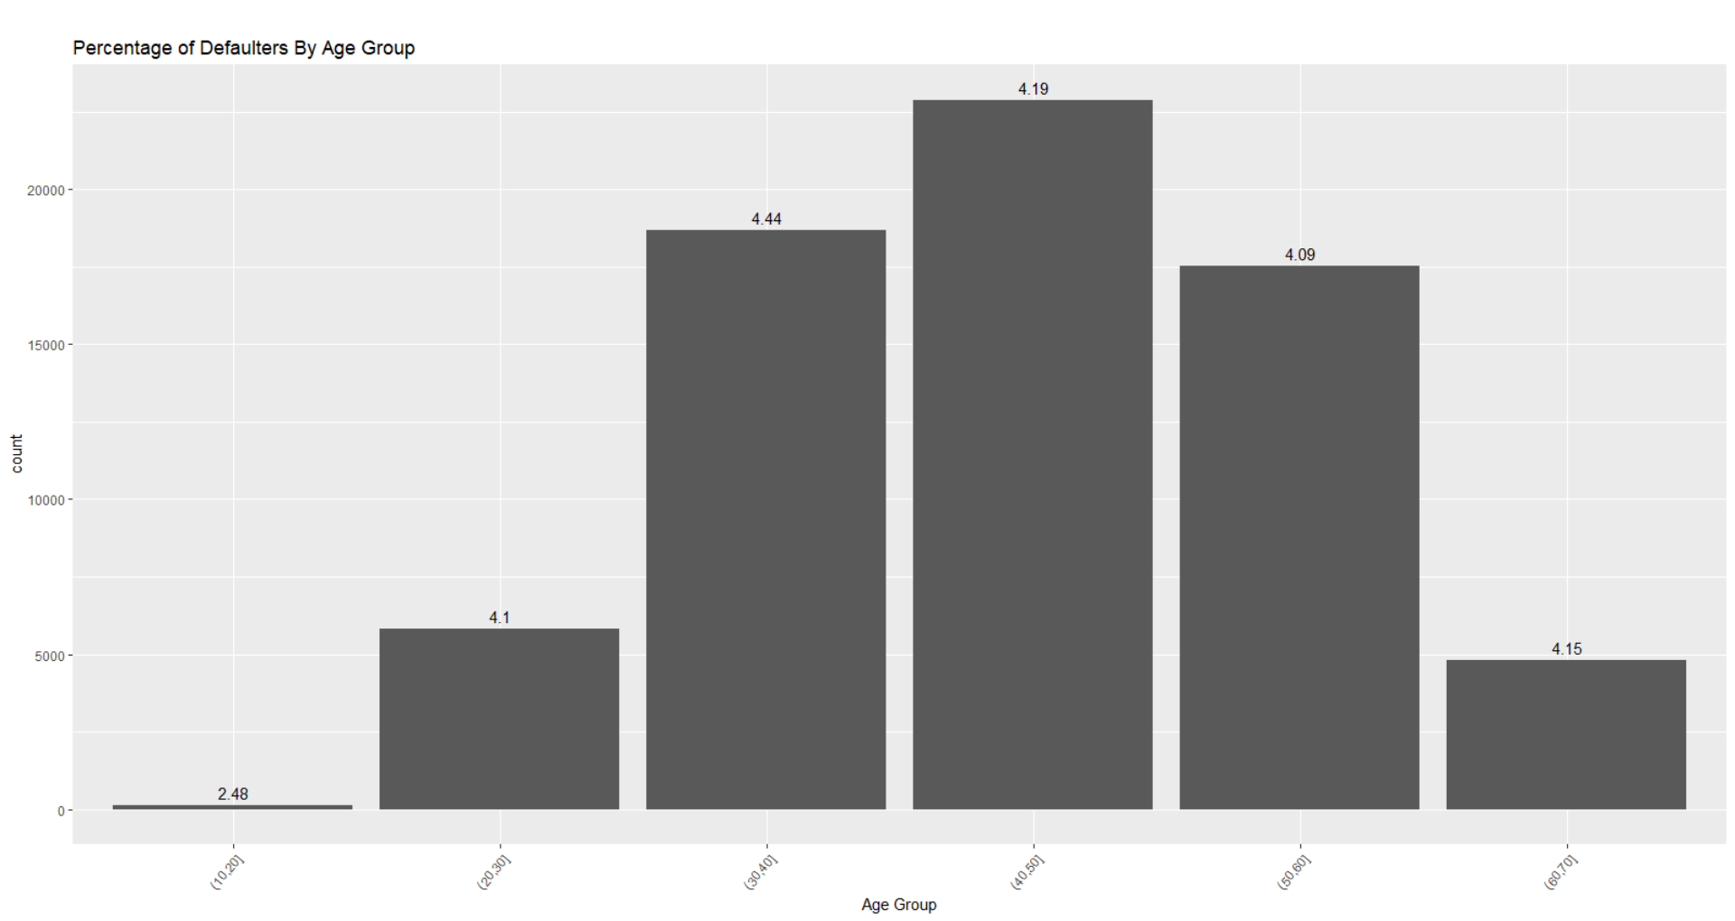
Age Group
There is no significant difference in percentage of defaulters in different Age group.
For Age Group (0-20], percentage is 2.48 but it’s not significant. Since number of applicant are very less.

Slide 20
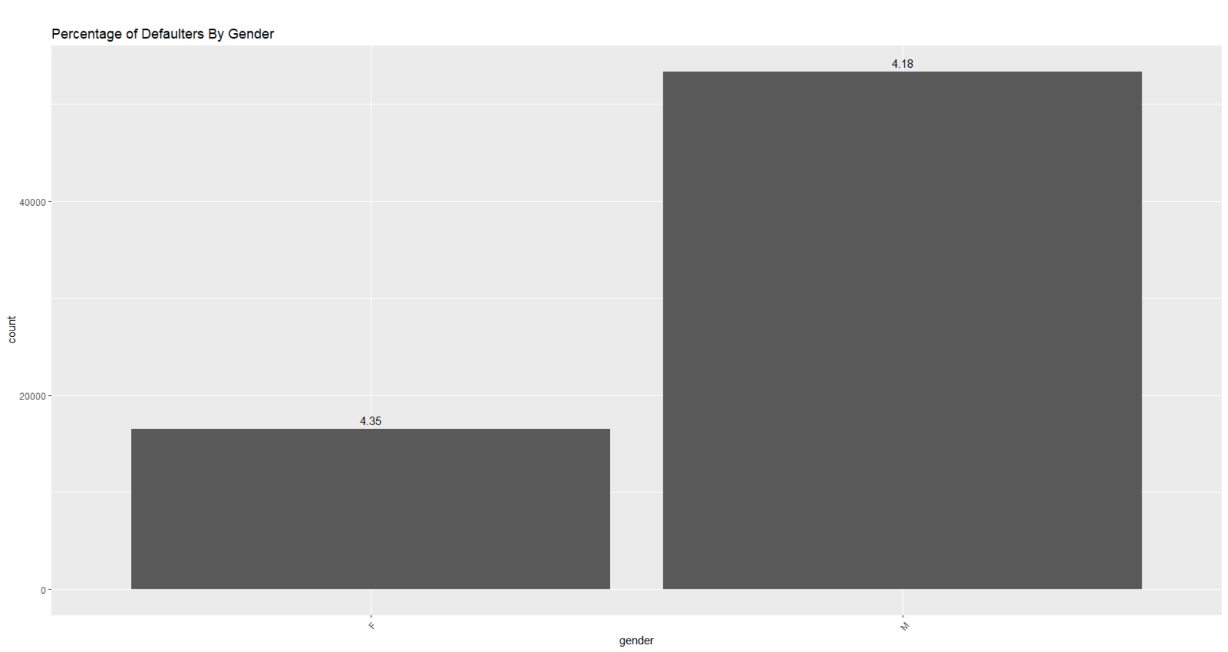
Gender
Percentage of Defaulter in Female (4.35%) is bit higher than defaulters in Male (4.18%).
Even though Female applicant are lesser than Male applicant, percentage of defaulter is high. But the difference is not big, it’s just 0.17%.
Total Female applicants are 16,506 and defaulters are 718. Difference of 0.17% in number of defaulters is 28, which is not large and also might be due to some unforeseen reasons
Gender is not significant to predict defaulters.

Slide 21
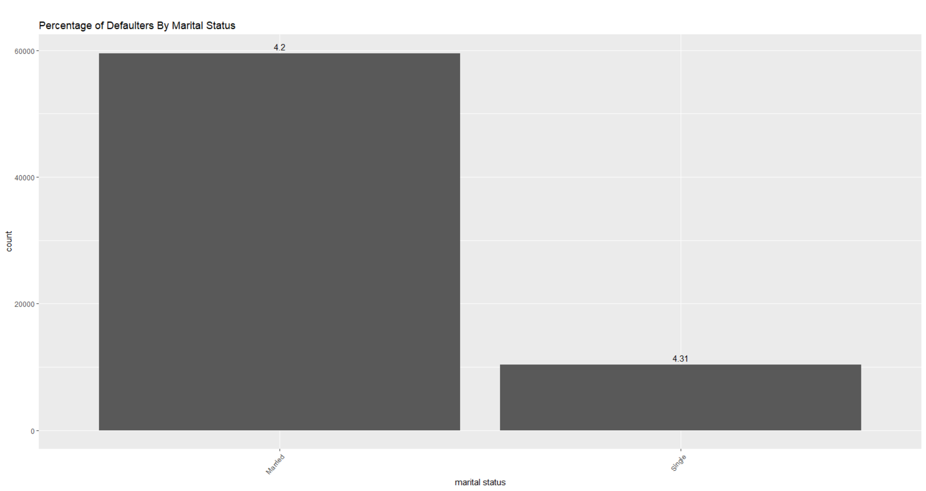
Marital Status
Percentage of Defaulter in Single (4.31%) is not very high compare to Married(4.20%)
Marital status is not significant to predict defaulters

Slide 22
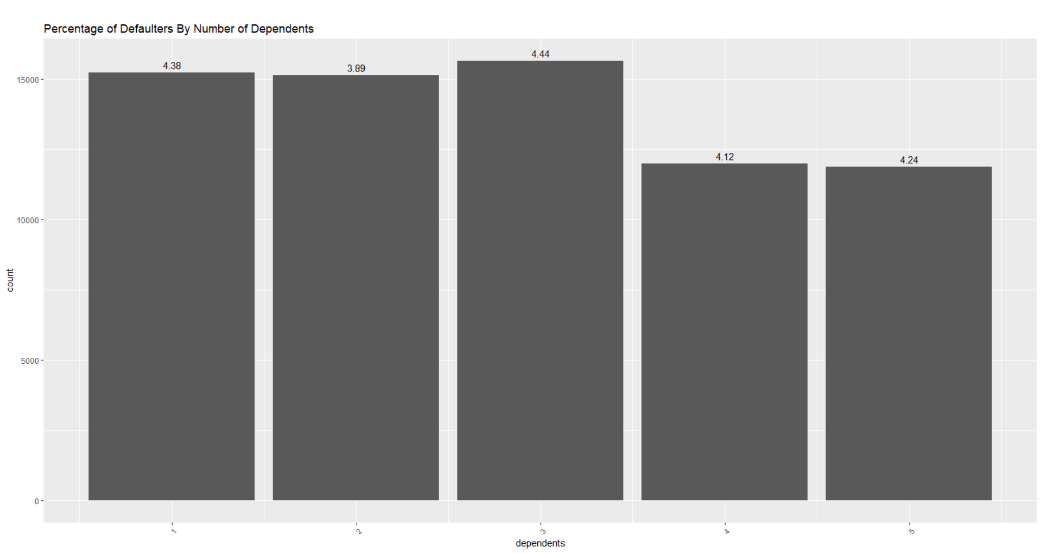
Number of dependents
Percentage of defaulters are decreasing as number of applicant are more than 3.
Change in percentage is significant almost 0.32%, which is significant.
Number of Dependents is significant to predict defaulters.

Slide 23
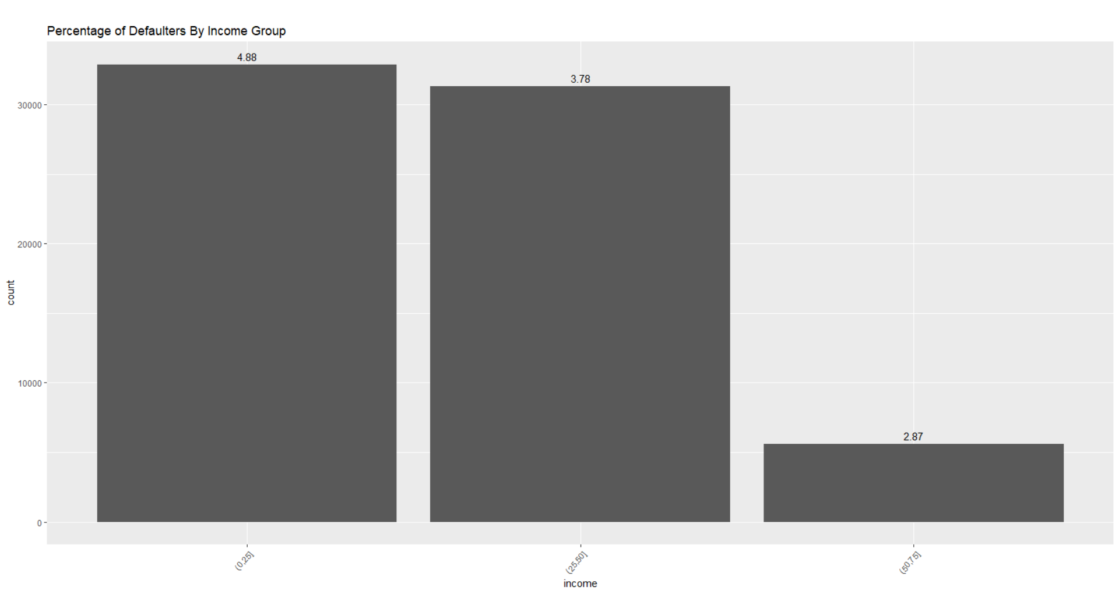
Income
Percentage of defaulters are decreasing as income of applicant is increase.
This difference is quite significant.
It’s obvious, as applicant earn more it’s very less likely that it will become defaulter.
There is a difference of 1.1% between first and second income group and 0.91% difference between second and third group.
Income of Applicant is very significant to predict defaulters.

Slide 24
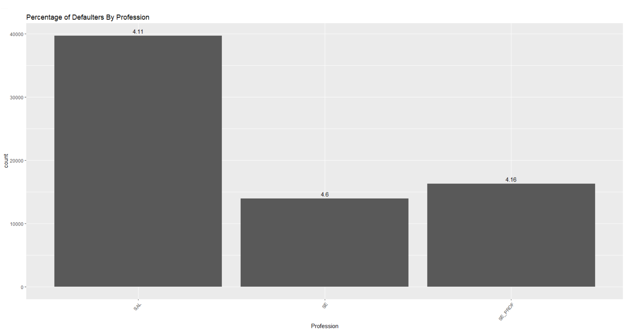
Profession
Percentage of Defaulters increase by 0.5%, if applicants are SE (Self Employed).
It might be due to lack of continuous income flow.
Procession of Applicant is significant to predict defaulters

Slide 25
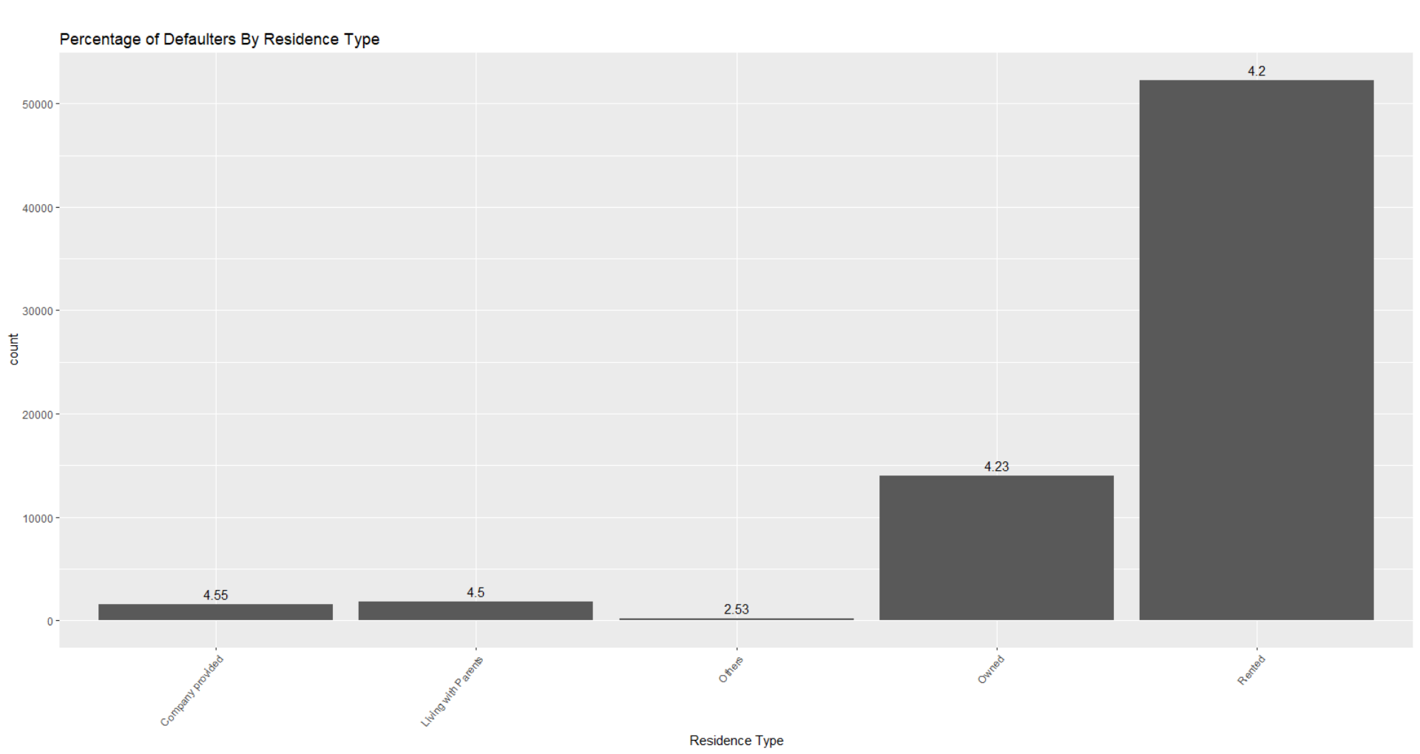
Residence Type
Applicant can be divided in two segment, as per graph.
Those who are self dependent, living in self owned or self rented residence and others dependent on other (Company Provided or leaning with parents).
Self dependent, applicant are less likely to default compare to others and difference is around 0.25%, Which can be significant.
Residence Type of Applicant is might be significant to predict defaulters

Slide 26
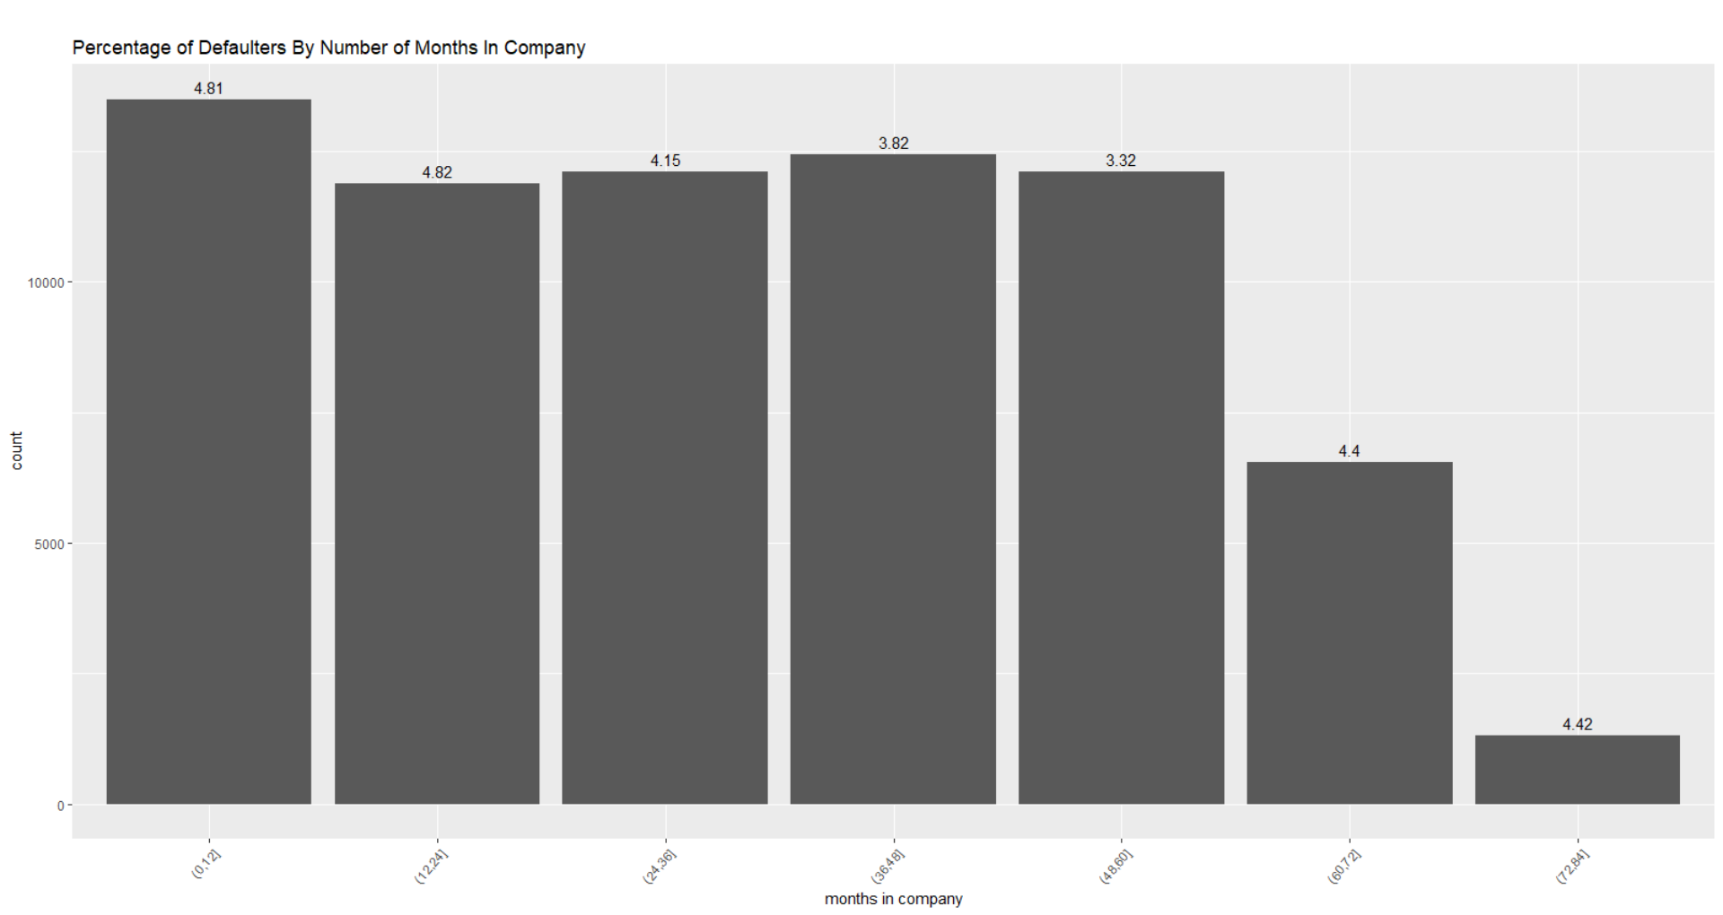
Months in Company
Applicants having 1 of 2 years of relationship with company are more likely to become defaulter compare to those who have 3 to 5 years with company.
Difference in percentage, is almost 1% between 1 to 2 years and 3 to 5 years.
But percentage of defaulters again goes high for 6 to 7 year duration.
Number of months in a Company might be significant to predict defaulters

Slide 27
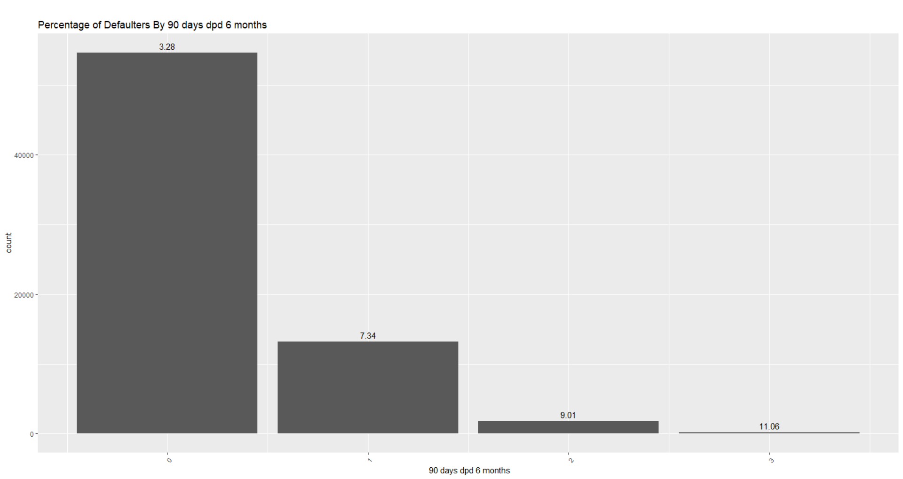
90 Days DPD in 6 Months
Applicant with 0, 90 days DPD in last 6 months having only 3.28% default rate.
Applicant having at least 1 90 days DPD in last 6 months, having 7.34% default rate. And it is increasing as number of 90 days DPD is increasing.
It is quite significant in predicting defaulter.
90 Days DPD in 6 Months is very significant.

Slide 28
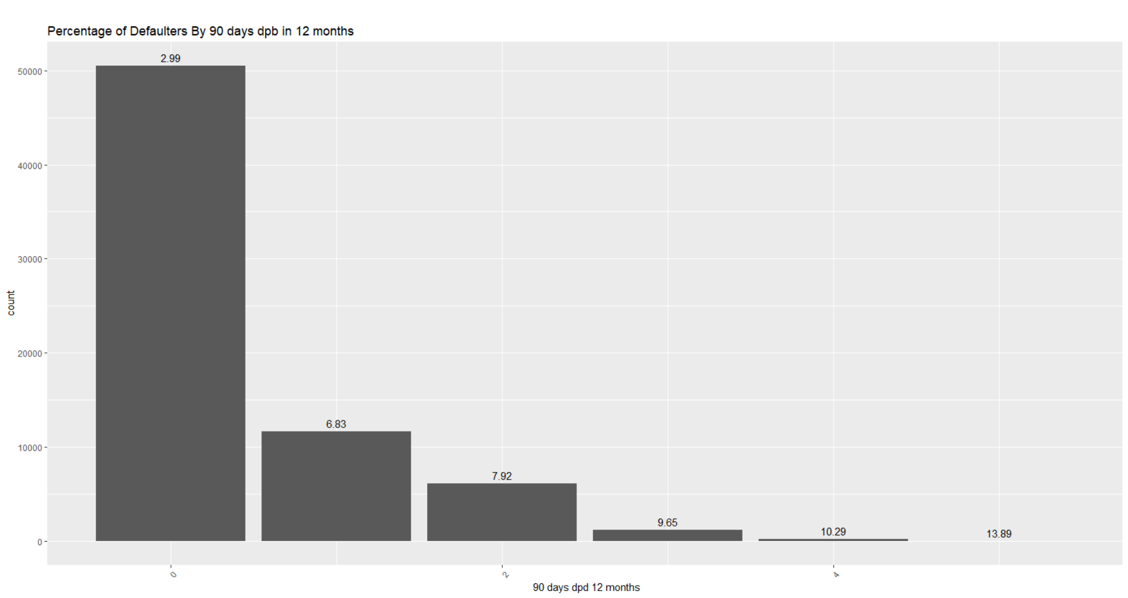
90 Days DPD in 12 Months
Applicant with 0, 90 days DPD in last 12 months having only 2.99% default rate.
Applicant having at least 1 90 days DPD in last 6 months, having 6.38% default rate. And it is increasing as number of 90 days DPD is increasing.
It is quite significant in predicting defaulter.
All DPD files might have correlation with other fields.
90 Days DPD in 12 Months is very significant.

Slide 29
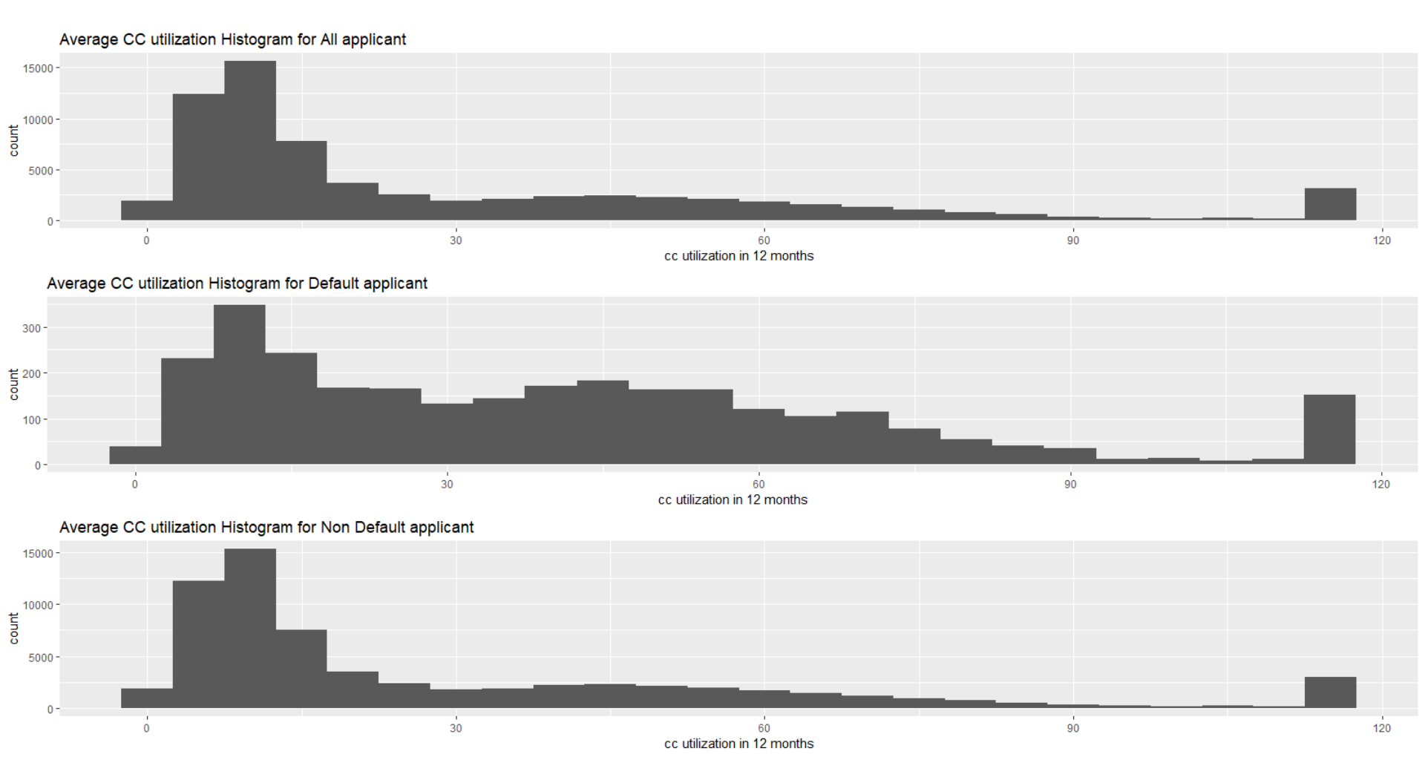
Avg. CC utilization
As per histogram, for all the applicant and non defaulter, number of applicant are decreasing as number of CC utilization is increasing.
But for defaulters, if CC utilization is between 30 to 90, default rate is significantly increasing. Even though over all applicant are less in that range.
It’s significant to predict defaulters.
Avg. CC utilization is very significant.

Slide 30
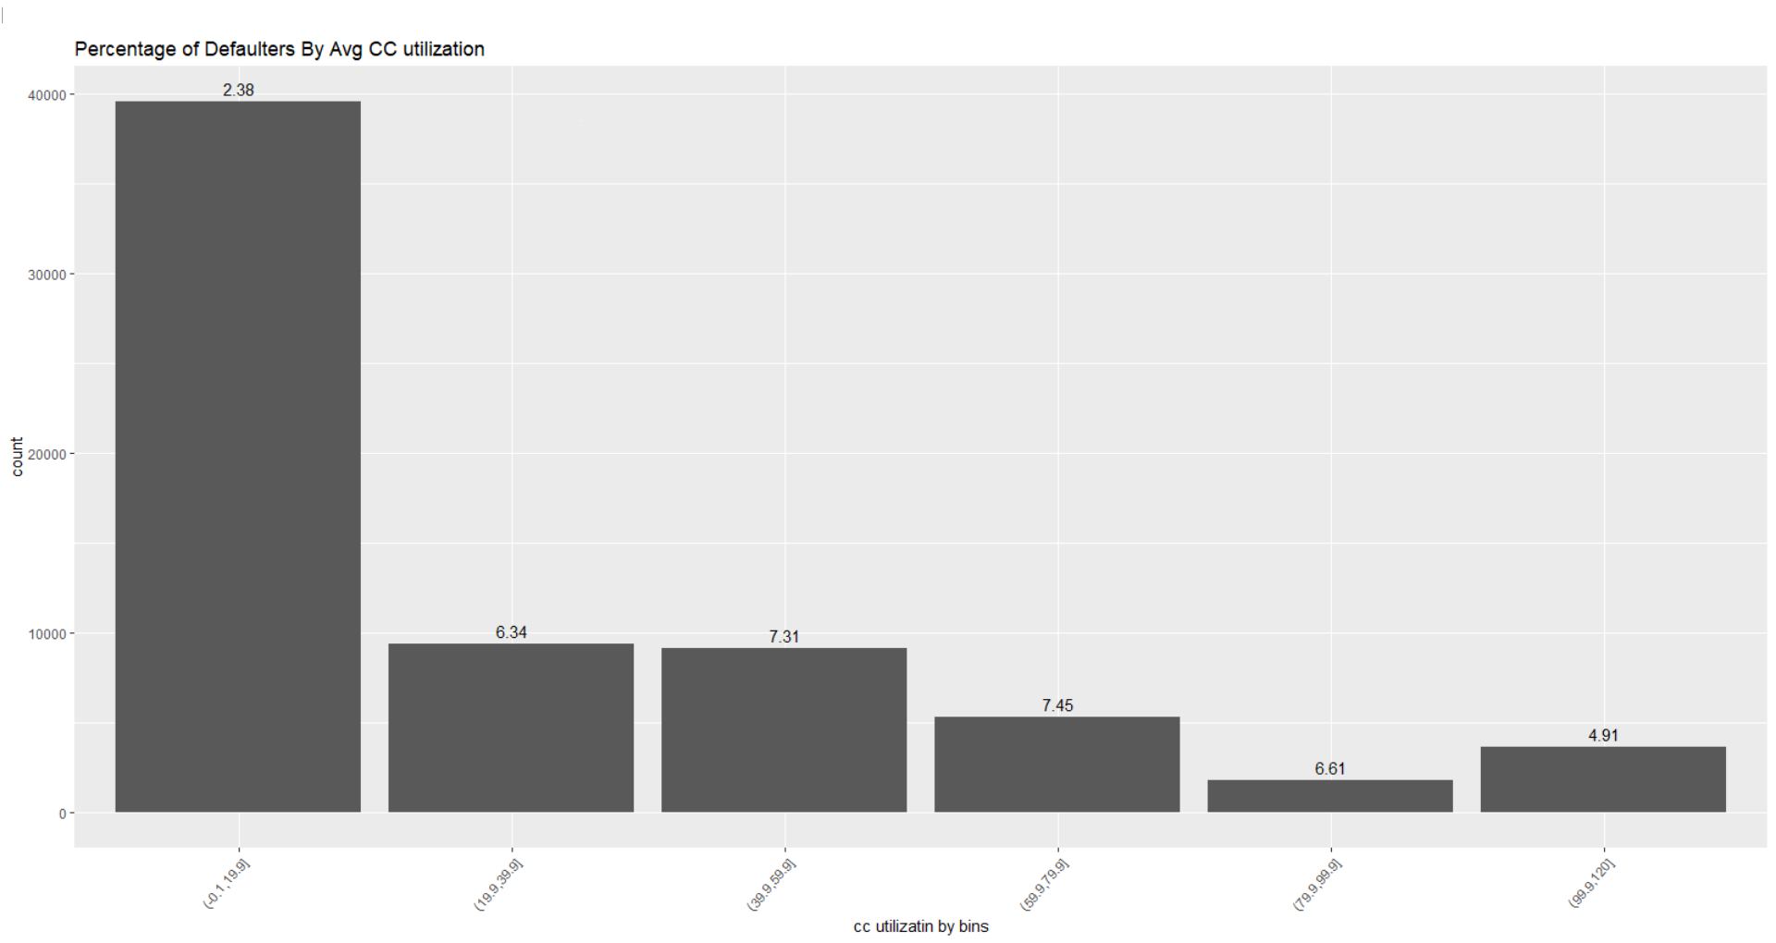
Avg. CC utilization Binned
If we Bin the CC utilization in we can see the impact clearly.
As number of cc utilization is increasing, percentage of defaulters are increasing.
Avg. CC utilization is very significant.

Slide 31
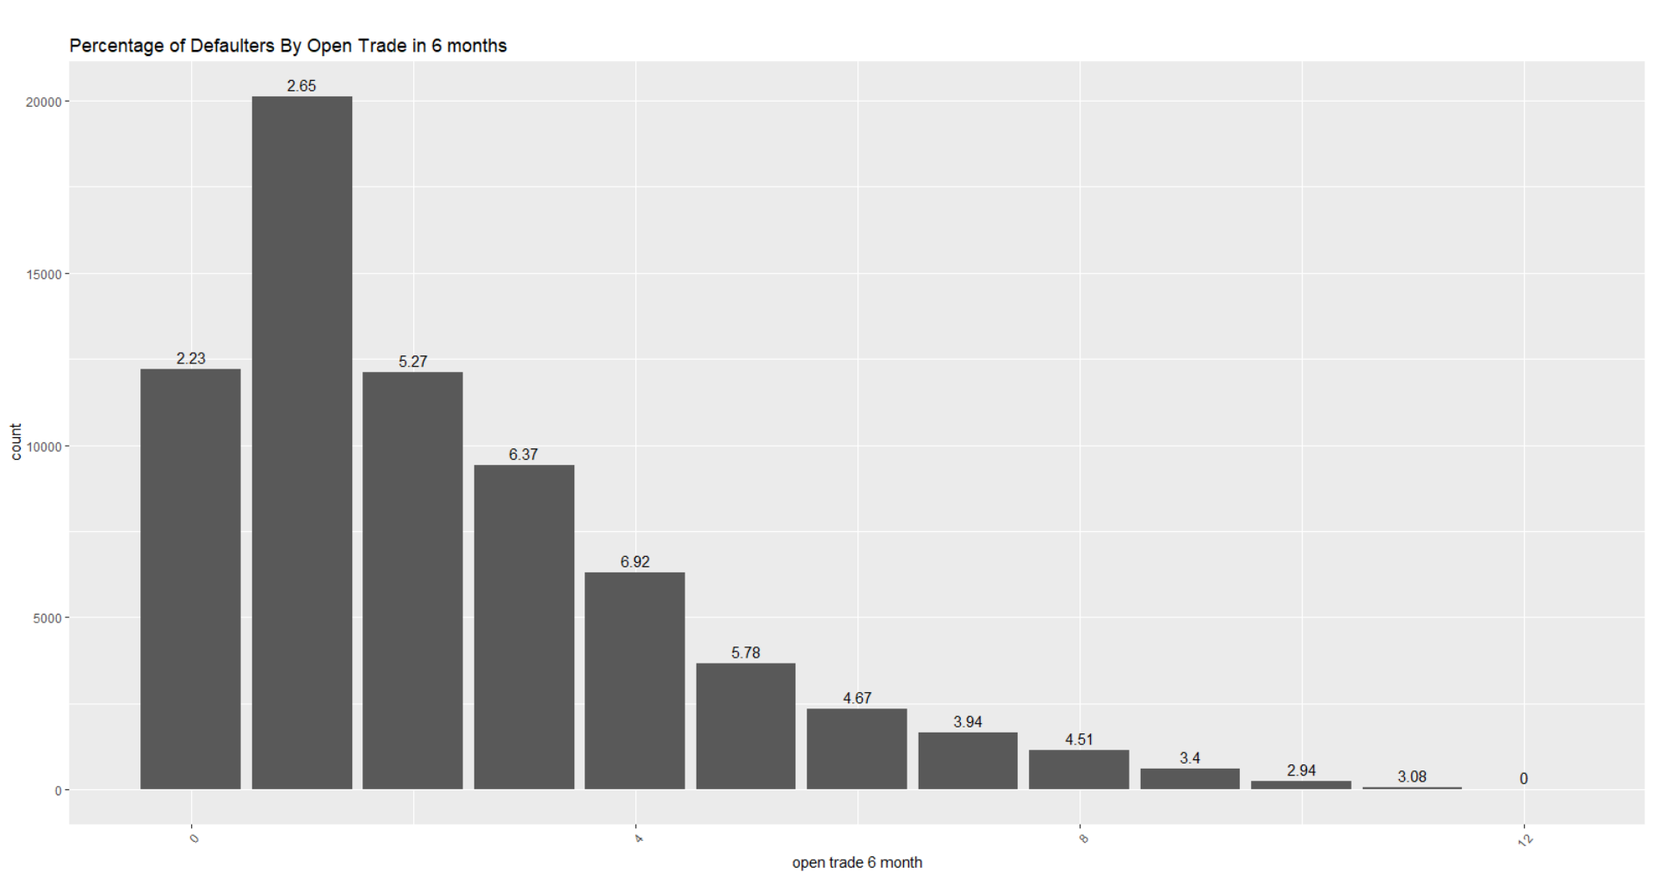
Open Trade in 6 Months
Large number of Applicant having 1 Open trade in 6 months.
As this number increases from 2 to 4, percentage of defaulters are increasing significantly and for 5 and above it’s decreasing as compare to 2 to 4.
Open Trade in 6 Months might be significant.
Other parameter like Open trade in 12 months, Open pl trade in 6 month, Open pl trade in 12 months, having same behavior as “Open trade in 6 months”. These variable will have the correlation.

Slide 32
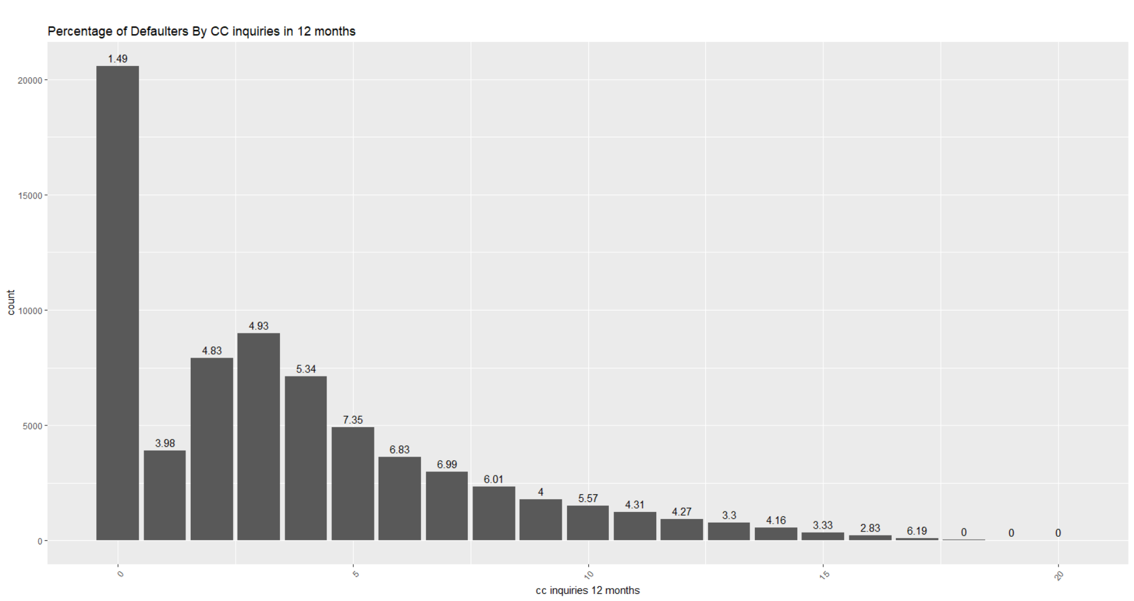
CC inquiry in 12 Months
Applicant doing on an average 2 to 7 cc inquiries in 12 months, are most likely to become defaulter.
CC inquiry in 12 Months might be significant.

Slide 33
Other parameters
Outstanding Balance (Binned)
Applicant having high outstanding amount are likely to become default. It’s not the same all the applicant. So this might be significant.
Total Trades (Binned)
Applicant having total trades between 10 to 15, having high default rate (7.11%), which is significantly high compare to others. This might be significant.
Open Home Loan
There is no clear evidence that having home loan will have any impact on applicant becoming default.
Open Auto Loan
Same as Home loan.

Slide 34
EDA Conclusion
After completing Multivariate EDA on available data set. We have found some of the parameters with high significance and some with low significance on customer default behavior. Though we found some parameter as low significance on default, we will use all of the parameter to build the model.
Below are list of parameter
Age
Number of dependents
Income
profession
Residence Type
Months in Company
90 Days DPD in 6 Months
90 Days DPD in 12 Months
Avg. CC utilization
Open trade in 6 months
Open trade in 12 month
Open pl trade in 6 months
Open pl trade in 12 months

Slide 35
Model Building Approach
Using technique like WOE and IV (Information Value) for variable. We will find most significant variable. Those variables will be used to build the model.
I will build predictive model to predict whether applicant will become default of not based on the data available. Model must have good AUC, Specificity and Sensitivity. I will try different modeling technique like Logistic regression with different logit option, Decision tree, Random Forest etc. Since our dataset is biased and having very less number of records with default status (4%). So we will try oversampling technique to make or dataset balanced.
I will select model with good evaluation and other performance parameter, will be selected. Based on model, we will calculate odds and logodds of application and based on predefined criteria I will build the scorecard. We will have cut of score as well, above which applicant will be consider as good applicant.
I will calculate the impact of predicting applicant as defaulter. Based on target % to predict the defaulter, we will calculated the trade for good customer to be predicted as defaulter and How what will be useful ness of using model compare to random decision.

Slide 36
Final Model Selection
After lots of iteration, I have selected below model as final model. I have also certain evaluation matrix taken into consideration to select final model. These parameters are evaluated for different cutoff for prob. I tired different oversampling technique to balance our dataset too.
Evaluation Matirx
Specificity: How good our model is to predict True Negative.
Sensitivity: How good our model is to predict True Positive.
AUC (Area under Curve): It should be as high as possible. High value shows model is very efficient is predicting correct values.
Accuracy: Over all accuracy of model.
KS Statistics: It’s measure to validate, how efficient our model is in differentiating between event and non events.
Evaluation Matrix Value At Cutoff (0.43)
Accuracy: 65%
Sensitivity: 63%
Specificity: 65%
AUC: 64%
KS Statistics: 28% at 4th Decile

Slide 37
Final Model
Final Model Formula
Call:
glm(formula = status ~ age + gender + dependents + income + education +
profession + months.in.company + num.60.dpd.or.worse.6.months +
num.30.dpd.or.worse.6.months + num.90.dpd.or.worse.12.months +
num.30.dpd.or.worse.12.months + avg.cc.utilization.12.months +
open.trades.in.12.months + open.pl.trades.in.6.months + open.pl.trades.in.12.months +
cc.inquiries.6.months + cc.inquiries.12.months + outstanding.balanace,
family = "binomial", data = train.demographic.credit.woe.data.rose)

Slide 38
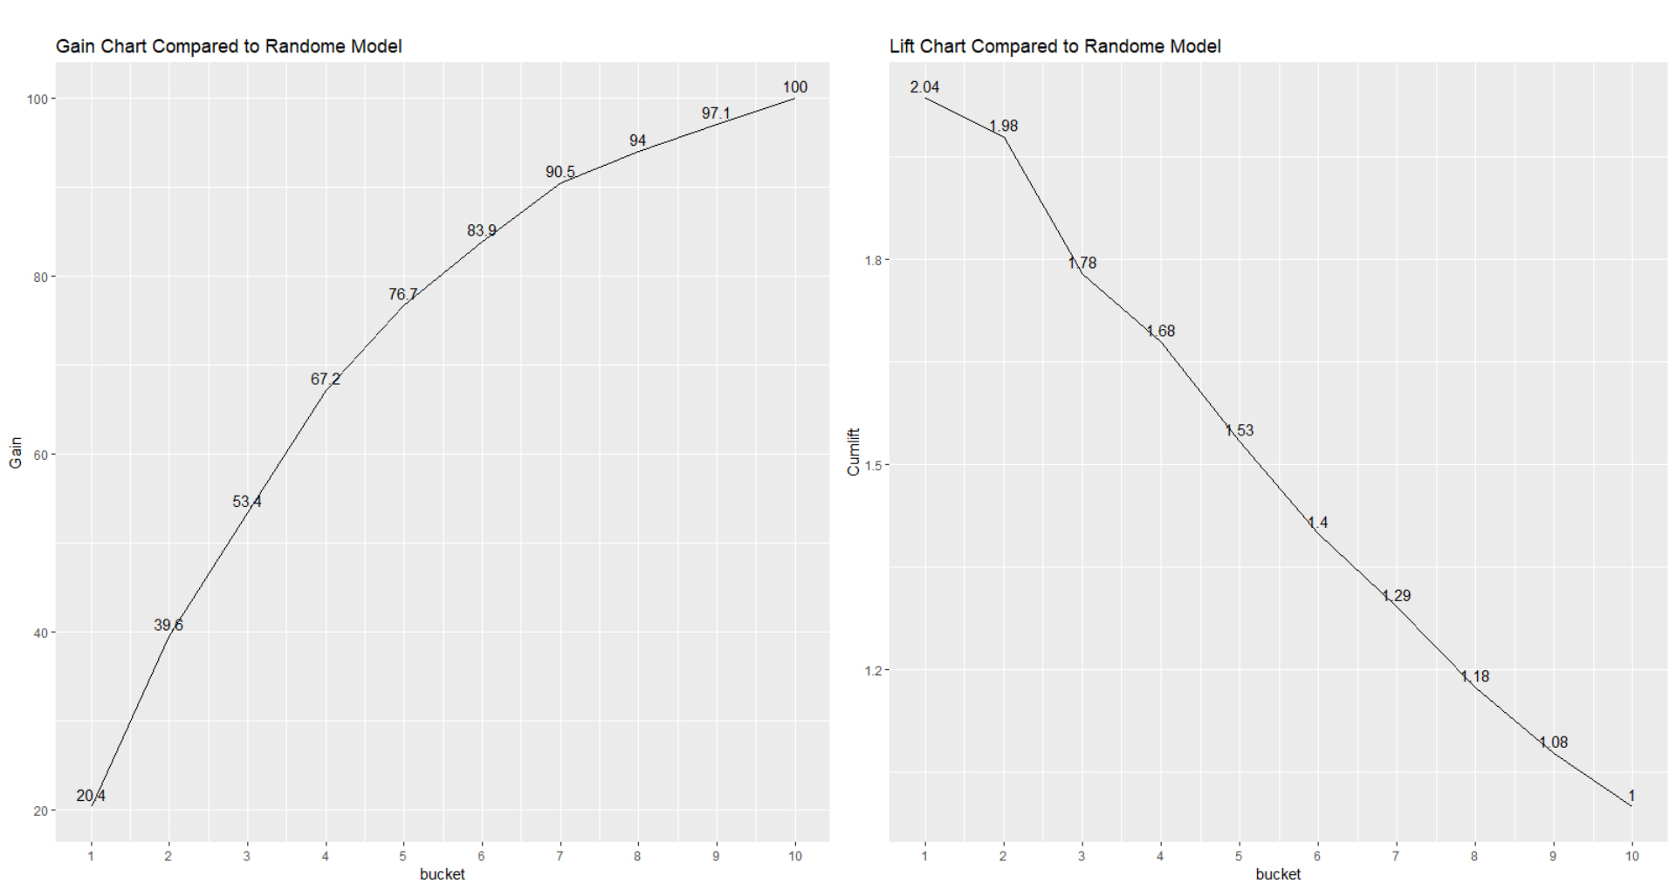
Model Lift and Gain Charts

Slide 39
Business Benefit Analysis Approach
Score card
Default cutoff score
Predict the score of rejected applications and do further analysis.
Trade of between Credit loss Improvement and Revenue loss
Based on Trade off and Bank acceptance rate new score cutoff will be decided.

Slide 40
Score Card
Criteria
With good to bad odds of 10 to 1 at the score of 400 doubling Every 20 points.
ScoreCard Details
Min Scroe: 311 at probability 0.68 (Means Higher the probability, lower the score)
Max Scroe: 384 at Probability 0.14 (Means Lower the probability, higher the score)
Score cutoff
Default score cutoff based on cutoff probability (0.43) is 342. We can approve application having scrore 342 and reject all having less than that.
Note:
This score cutoff is the default decided based on cutoff probability. But we will also come up with new score cutoff based on banks acceptance rate. Based on trade off between Credit loss improvement and Revenue loss.

Slide 41
Trade Off
Impact on Default cut off score (342)
If we approve application based on default cutoff score, we got default score using prob cutoff. To cover good number of defaulters.
But at the same point we will loss the revenue due to not giving loan to potential customers. Below are some analysis points.
Approval Rate: 64%
New credit loss will be $1,476,485,921
Improvement over total credit loss is (old credit loss – new credit loss) = $3,704,984,230 - $1,476,485,921 = $2,228,498,309
Revenue loss is: $ 28,608,708,471. There is the possibility that in future these customers, might become defaulter. So it will cause a credit loss.
$2,228,498,309 amount is what we save using model and not giving loan to correctly predicted defaulters. These is a clear gain.

Slide 42
Trade Off
Analysis with Different cutoff Score
We did the trade off analysis by selecting different cutoff score.
At Cutoff score: 331
Approval rate: 81.4%
New credit loss will be $ 2,405,027,806, Which is 64% or overall credit loss. Compare with cutoff score 342 it’s increased by 25%
Revenue loss is: 14,514,966,093, which is 17.38% of overall revenue. Compare with cutoff score 342, it’s decreased by almost 17%.
Also, as per trend in graph for different approval rate. After 81% of approval rate. Change in credit loss is very sharp.
Finale Cutoff Score
As per analysis, new cutoff score is 331. If applicant score more than 331, it will be considered as eligible.

Slide 43
Trade Off Graph

Slide 44
Rejected Application Analysis
Rejected Application
Around 1425 applications are rejected earlier, those are having $1,489,483,933 of outstanding amount. It’s a clear loss to bank.
At a first glass we can say $1,489,483,933 is a clear loss but applicant might become defaulters. Hence we can’t say it’s a clear loss.
Rejected Application using Model
Using model to approve application, 191 applications are approved over 1425 rejected. Those 191 application having outstanding balance of around $191,227,155.
This $191,227,155 amount is revenue gain using model.

